Slide 1
PROTECT WHAT MATTERS
Shubham Jindal

Slide 2
ABOUT ME
Technical Lead
ex-IIT Delhi
Full Stack Developer
Conference Speaker

Slide 3
Atoms are building blocks of matter
APIs
application

Slide 4
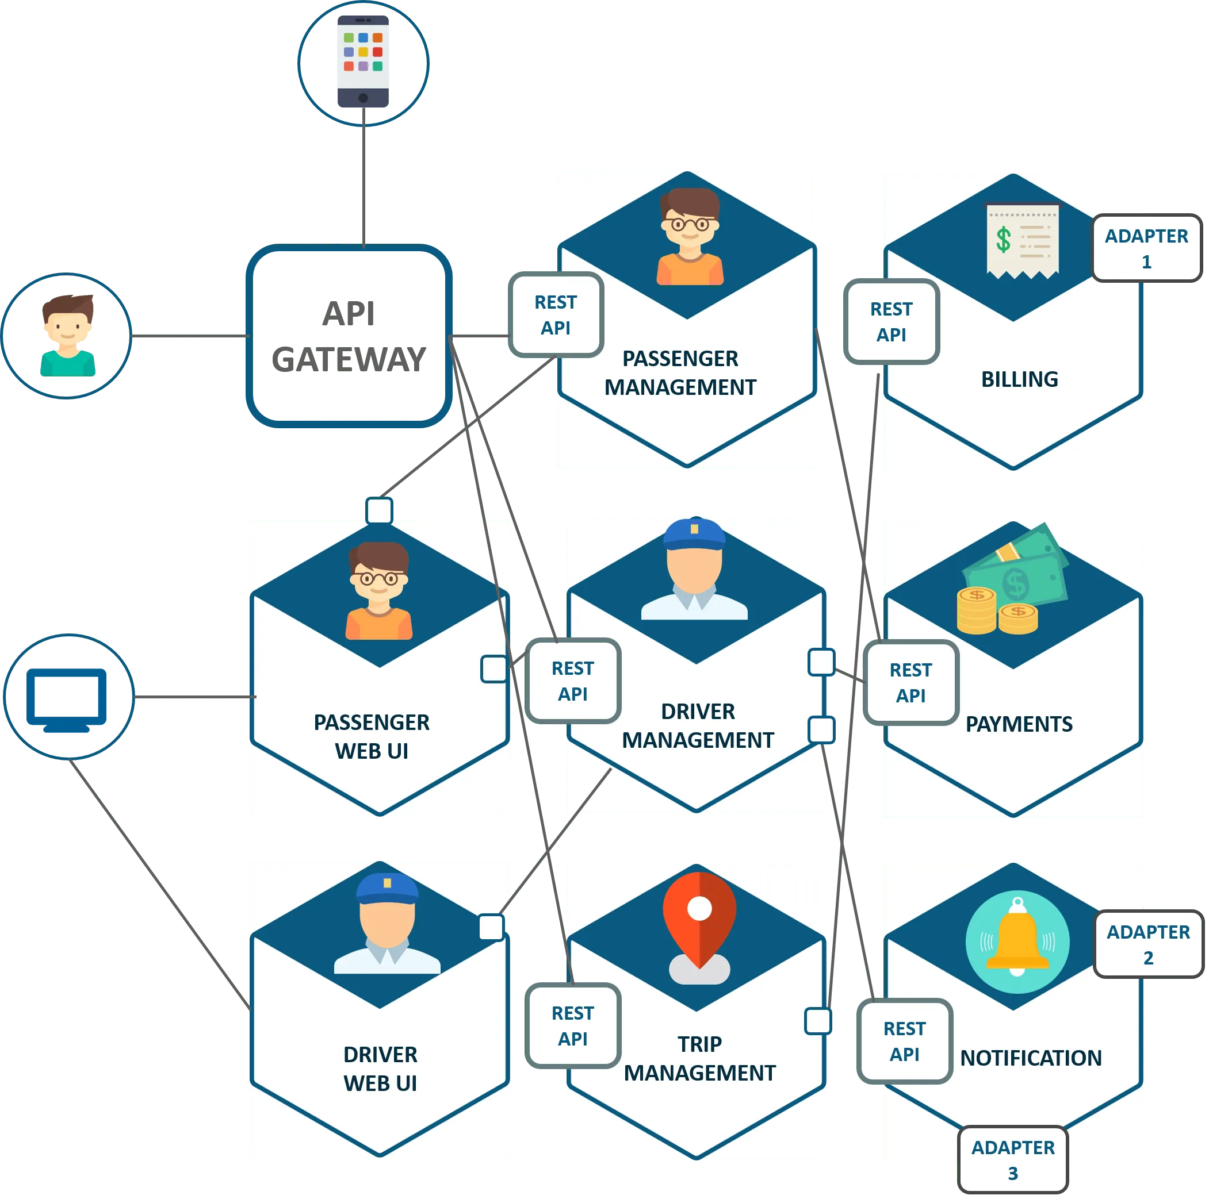
Microservices

Slide 5
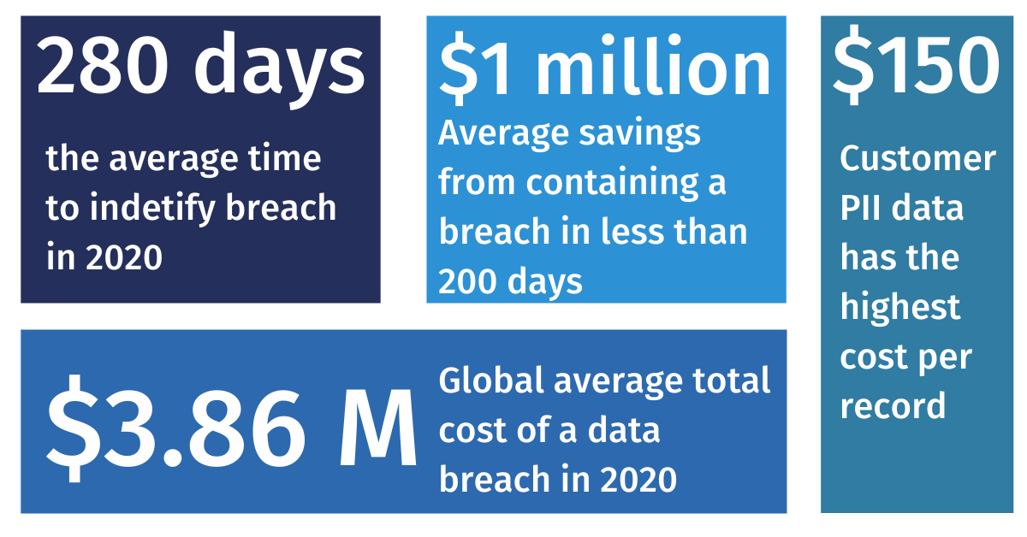
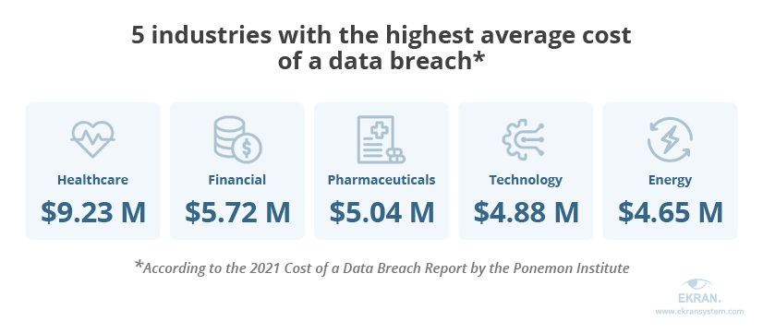
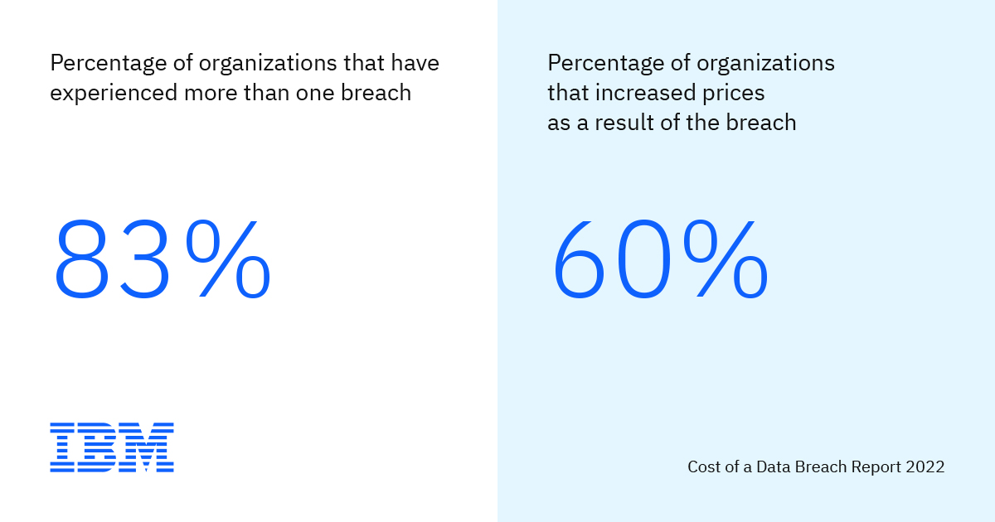
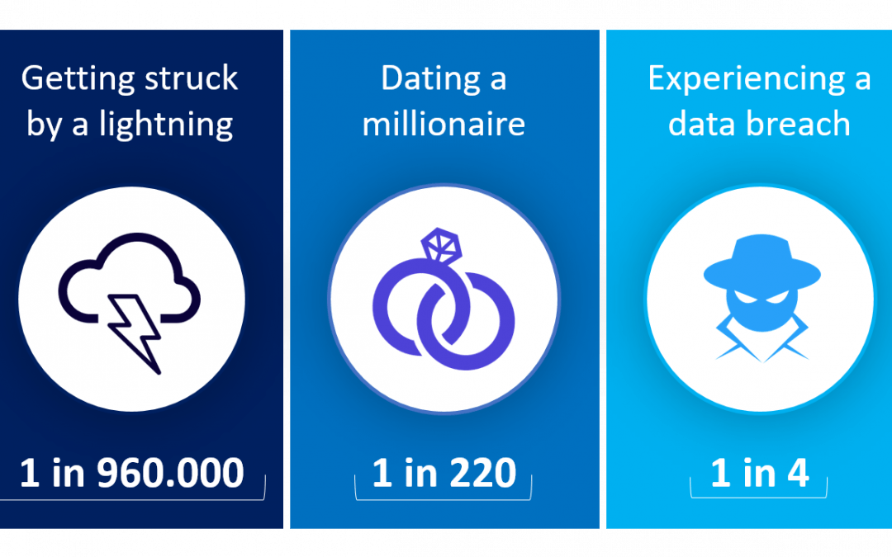
APIS - WHY PROTECT?

Slide 6
VISIBILITY

Slide 7
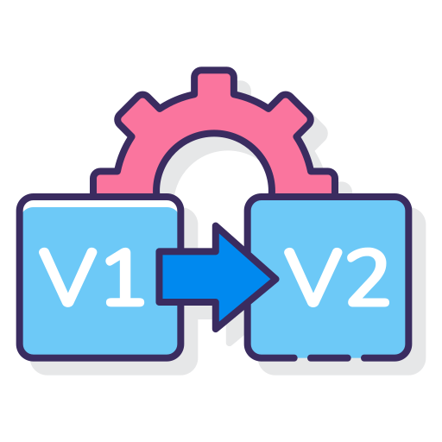
How many apis?
Attack Surface
ACCESS CONTROL
VERSIONING
Higher Attack Surface
Public APIs
Restrict the Public APIs
Admin v/s User
Who is accessing?
RBAC
Older APIs
Frequent Attacks
Do no let older APIs continue to function

Slide 8
rISKY apis
LIKELIHOOD
Impact
Public
Sensitivity
Popularity
Authentication
Encryption
Sentry
Vulnerability

Slide 9
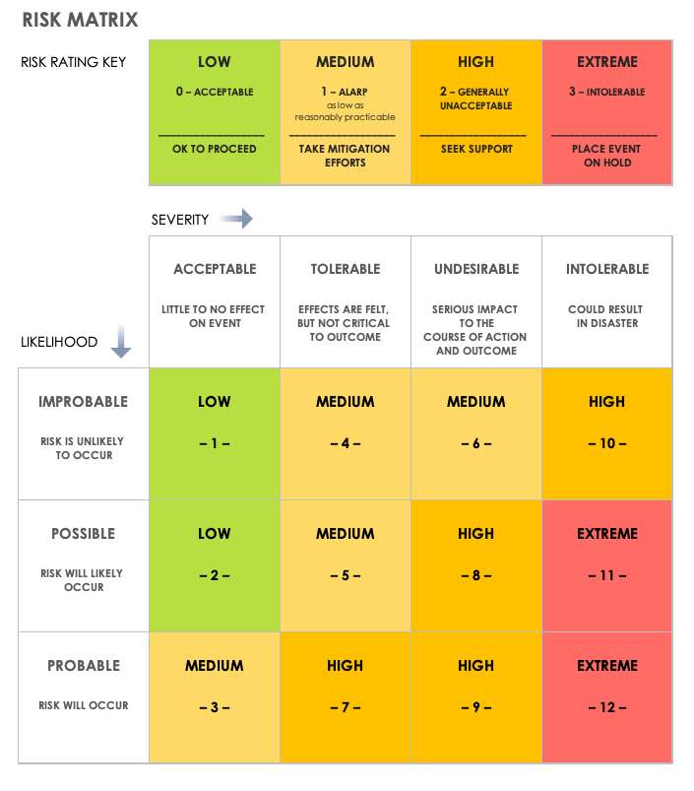
RISK MATRIX

Slide 10
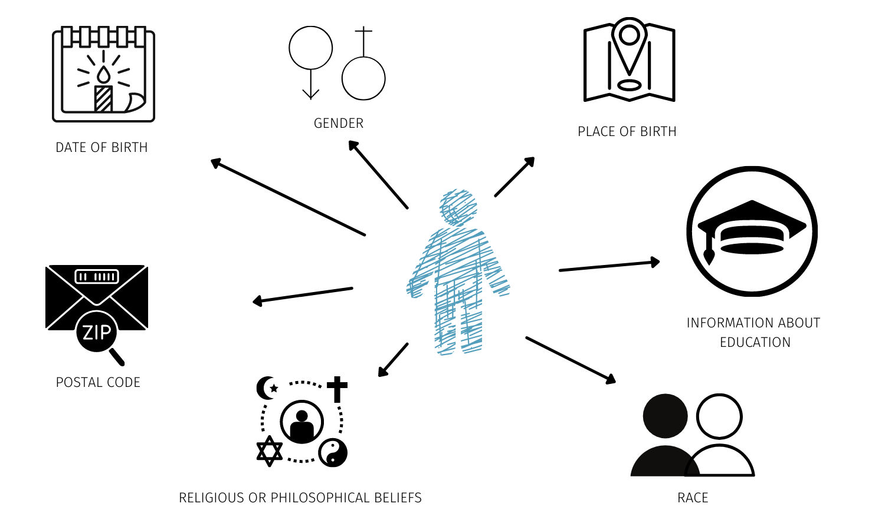
sENSITIVE DATA

Slide 11
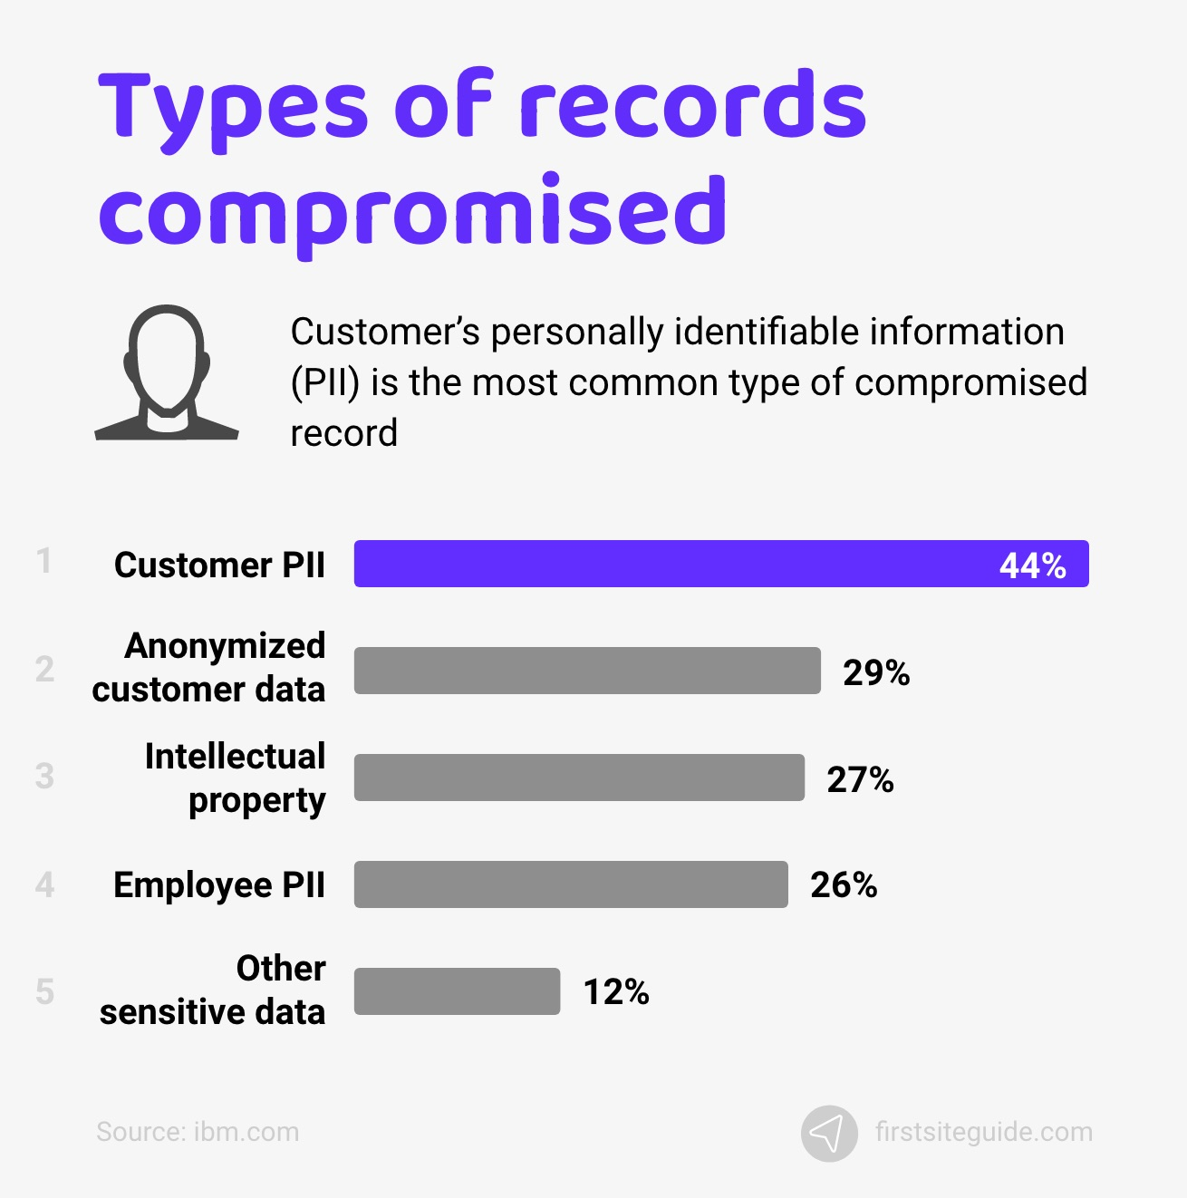
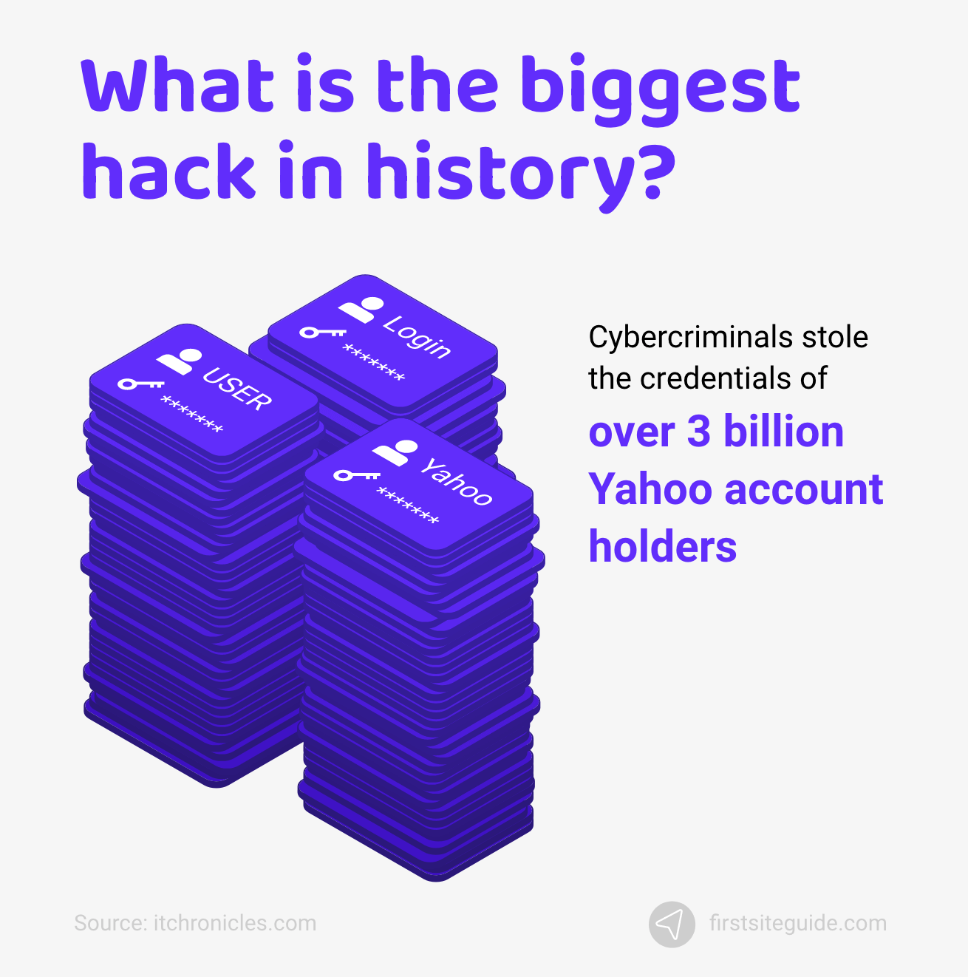

Slide 12
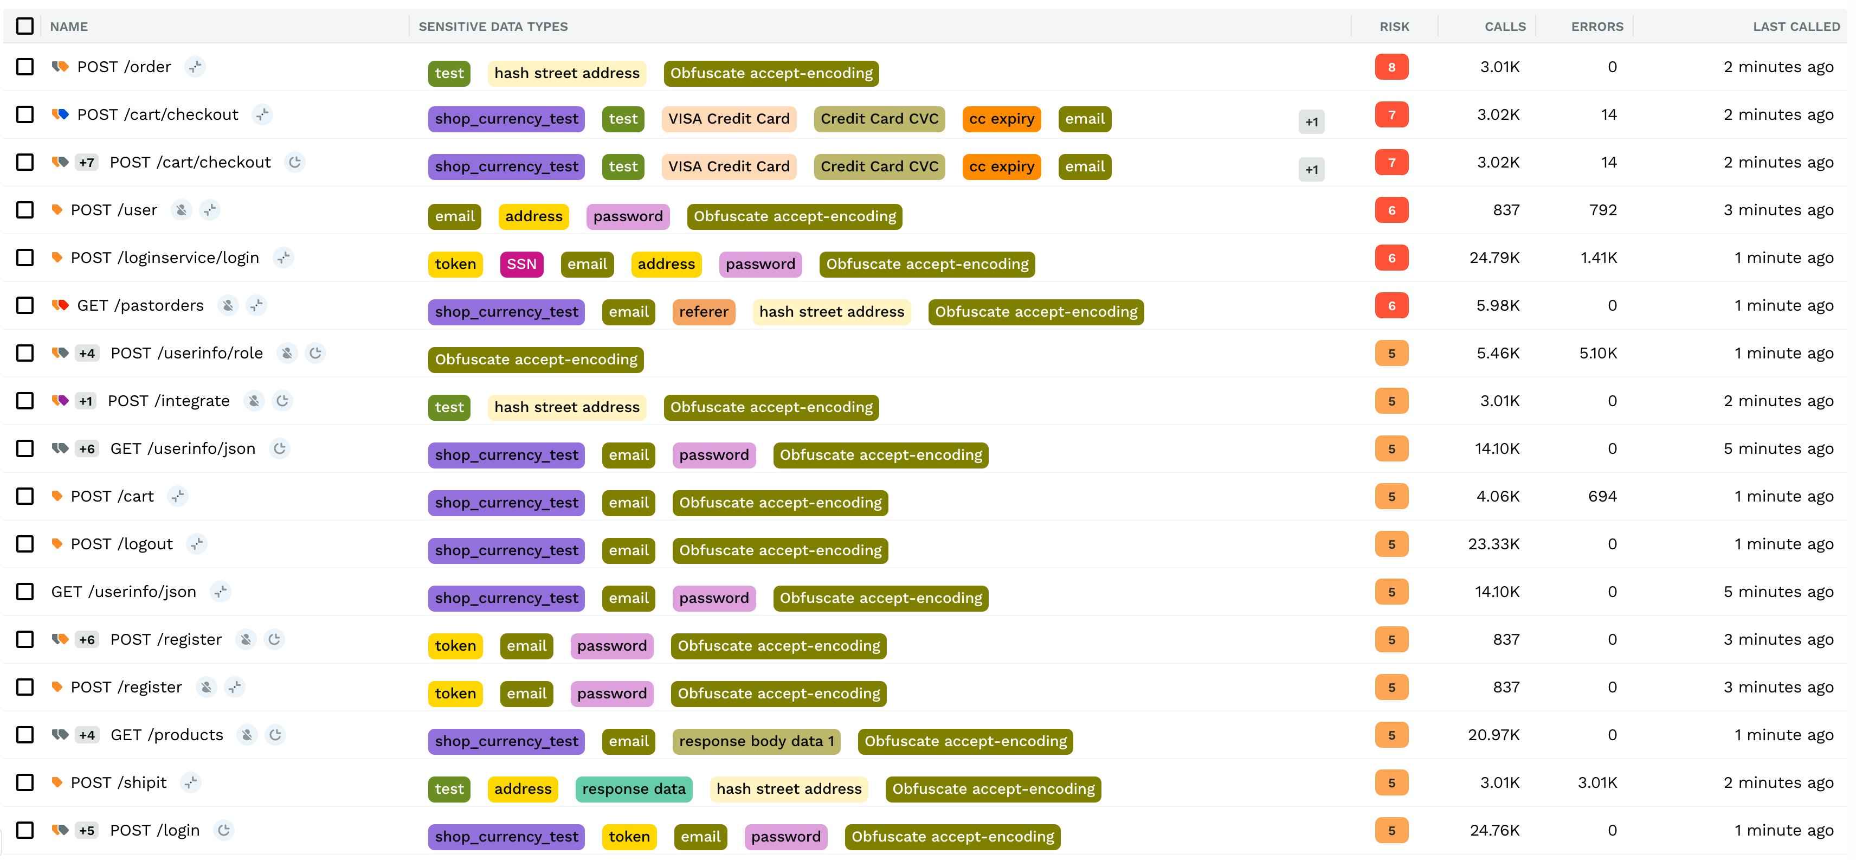

Slide 13
BEHAVIOR

Slide 14
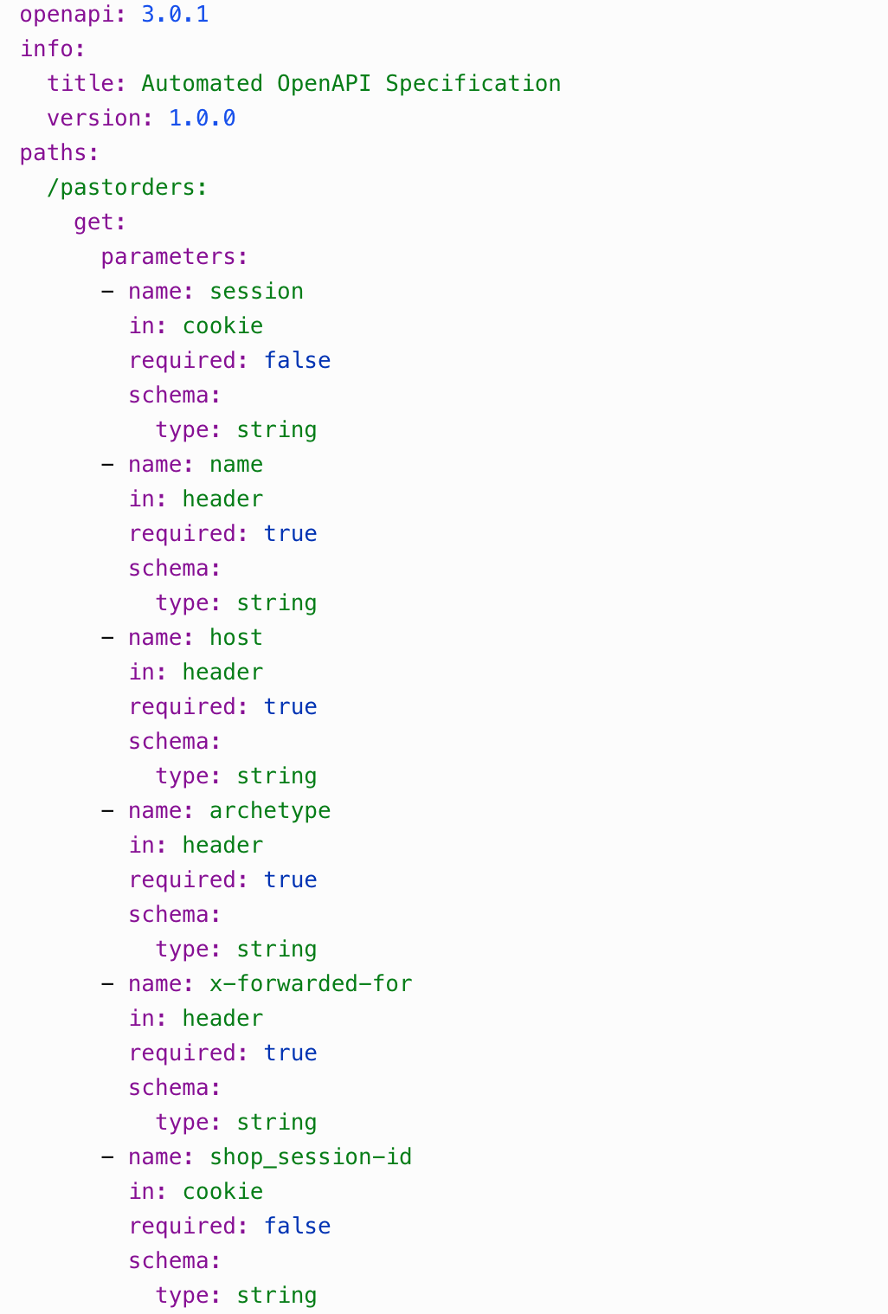
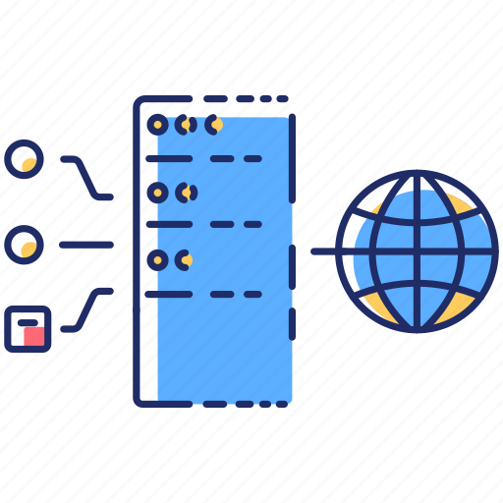
Open api specification
Traffic
Proxy
Api behavior
models
Open api

Slide 15
Vulnerabilities
Lack of encryption
Parameter has URL
Missing X-Content-Type
header
API
Query Param
has
sensitive data
Missing HSTS header
Basic Authentication

Slide 16
Shift left

Slide 17
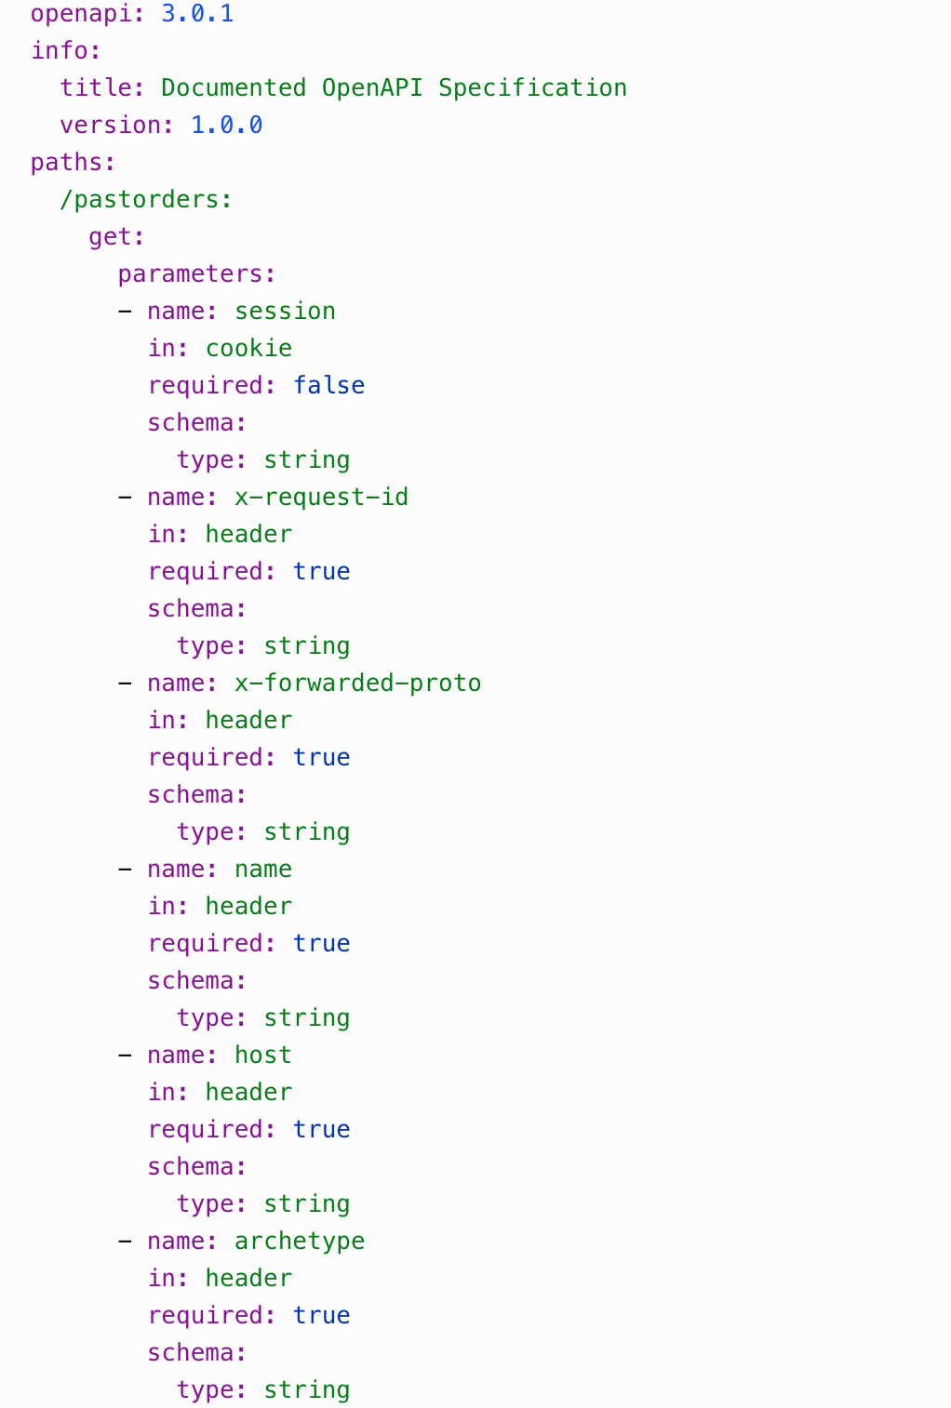
CONFORMANCE ANALYSIS
Open API
(documented by developers)
Open API
(generated by tool)

Slide 18
APIs that your company uses, but doesn’t track
APIs that your company tracks, but doesn’t use
Shadow
Orphan
Leaking user data without your consent or knowledge
Performing poorly with sporadic downtimes or unpredictable response times
Lacking the required security and privacy standards to keep your business in compliance
Mismatch
Provides an opportunity for attackers to mis-use and steal data
Un-necessary cost of tracking and maintaining outdated APIs
No attention for proper security configurations, making it more attack prone
Status Code
Content Type
Parameters that your company uses, but doesn’t track
Parameters that your company tracks, but doesn’t use
Shadow
Orphan
Mismatch
Type
Range
Required

Slide 19
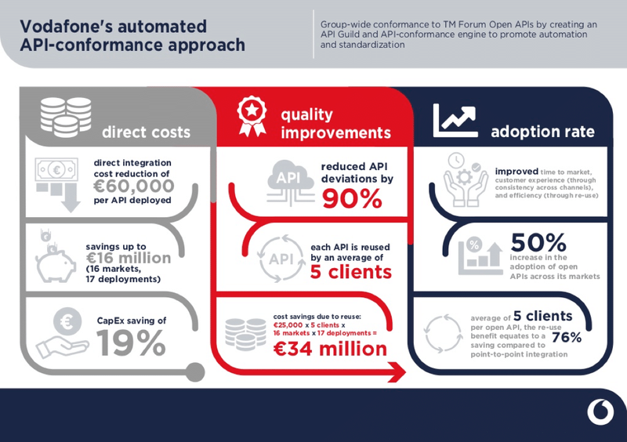

Slide 20
ACTIVE SECURITY TESTING

Slide 21
VISIBILITY
BEHAVIOR
Shift left
Too Many APIs
Open API
Conformance Analysis
Risk Score
Vulnerabilities
Active Security Testing

Slide 23
THANKS!

